Slide 1
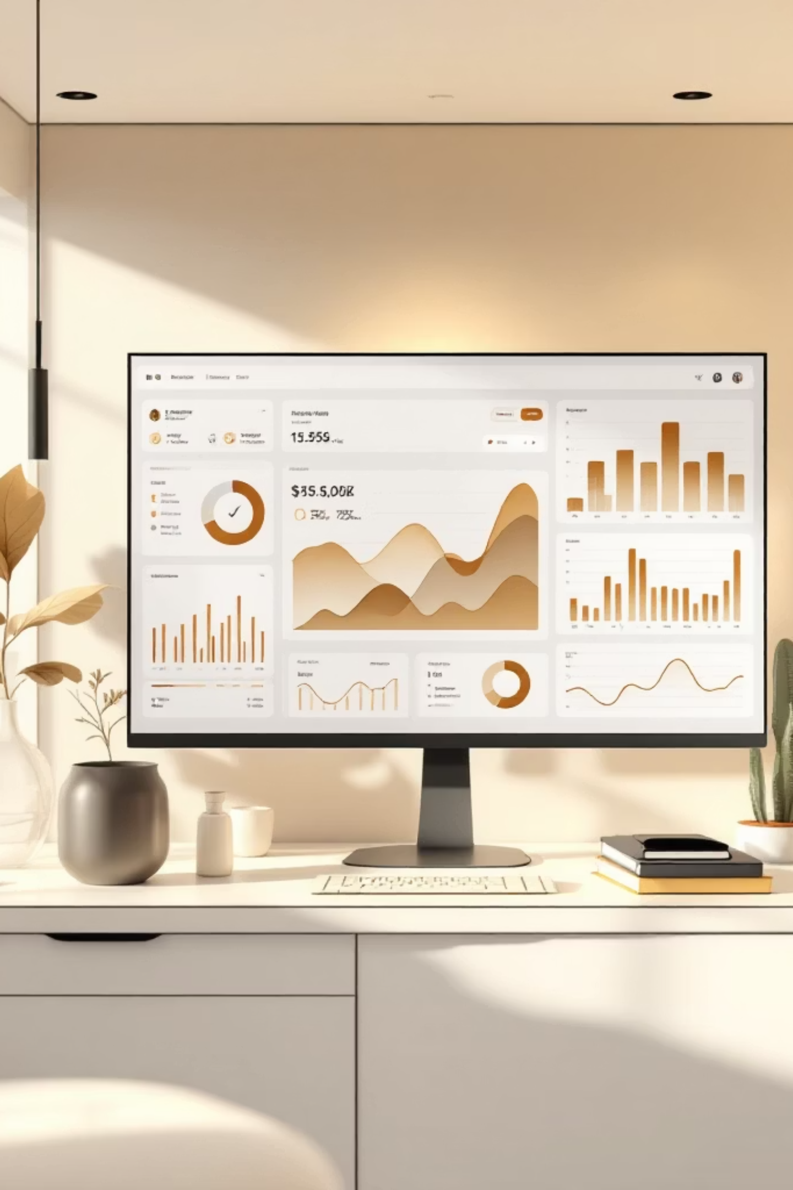
Customer Shopping Behavior Analysis
Uncovering insights from 3,900 purchases to drive strategic decisions

Slide 2
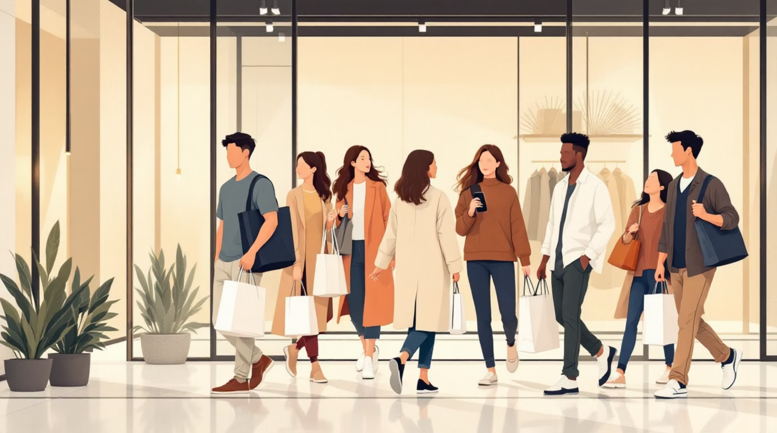
OVERVIEW
Project Scope
Dataset Size
3,900 transactions analyzed
Key Focus
Spending patterns, segments, preferences
Goal
Guide strategic business decisions

Slide 3



DATA FOUNDATION
Dataset Summary
Demographics
Purchase Details
Behavior Metrics
Age, gender, location, subscription status
Item, category, amount, season, size, color
Discounts, promo codes, frequency, ratings, shipping

Slide 4
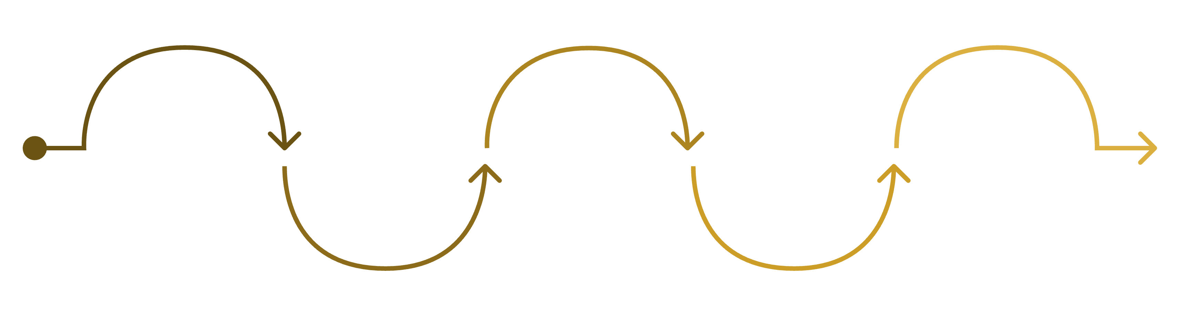
PYTHON ANALYSIS
Data Preparation Process
Explore & Clean
Engineer Features
Load Data
Standardize Columns
Database Integration
Assess missing values; median imputation
Create age groups and purchase metrics
Import raw datasets into workspace
Normalize names, types, and formats
Save cleaned dataset to DB
Cleaned dataset with median imputation for 37 missing review ratings, created age groups and purchase frequency metrics

Slide 5
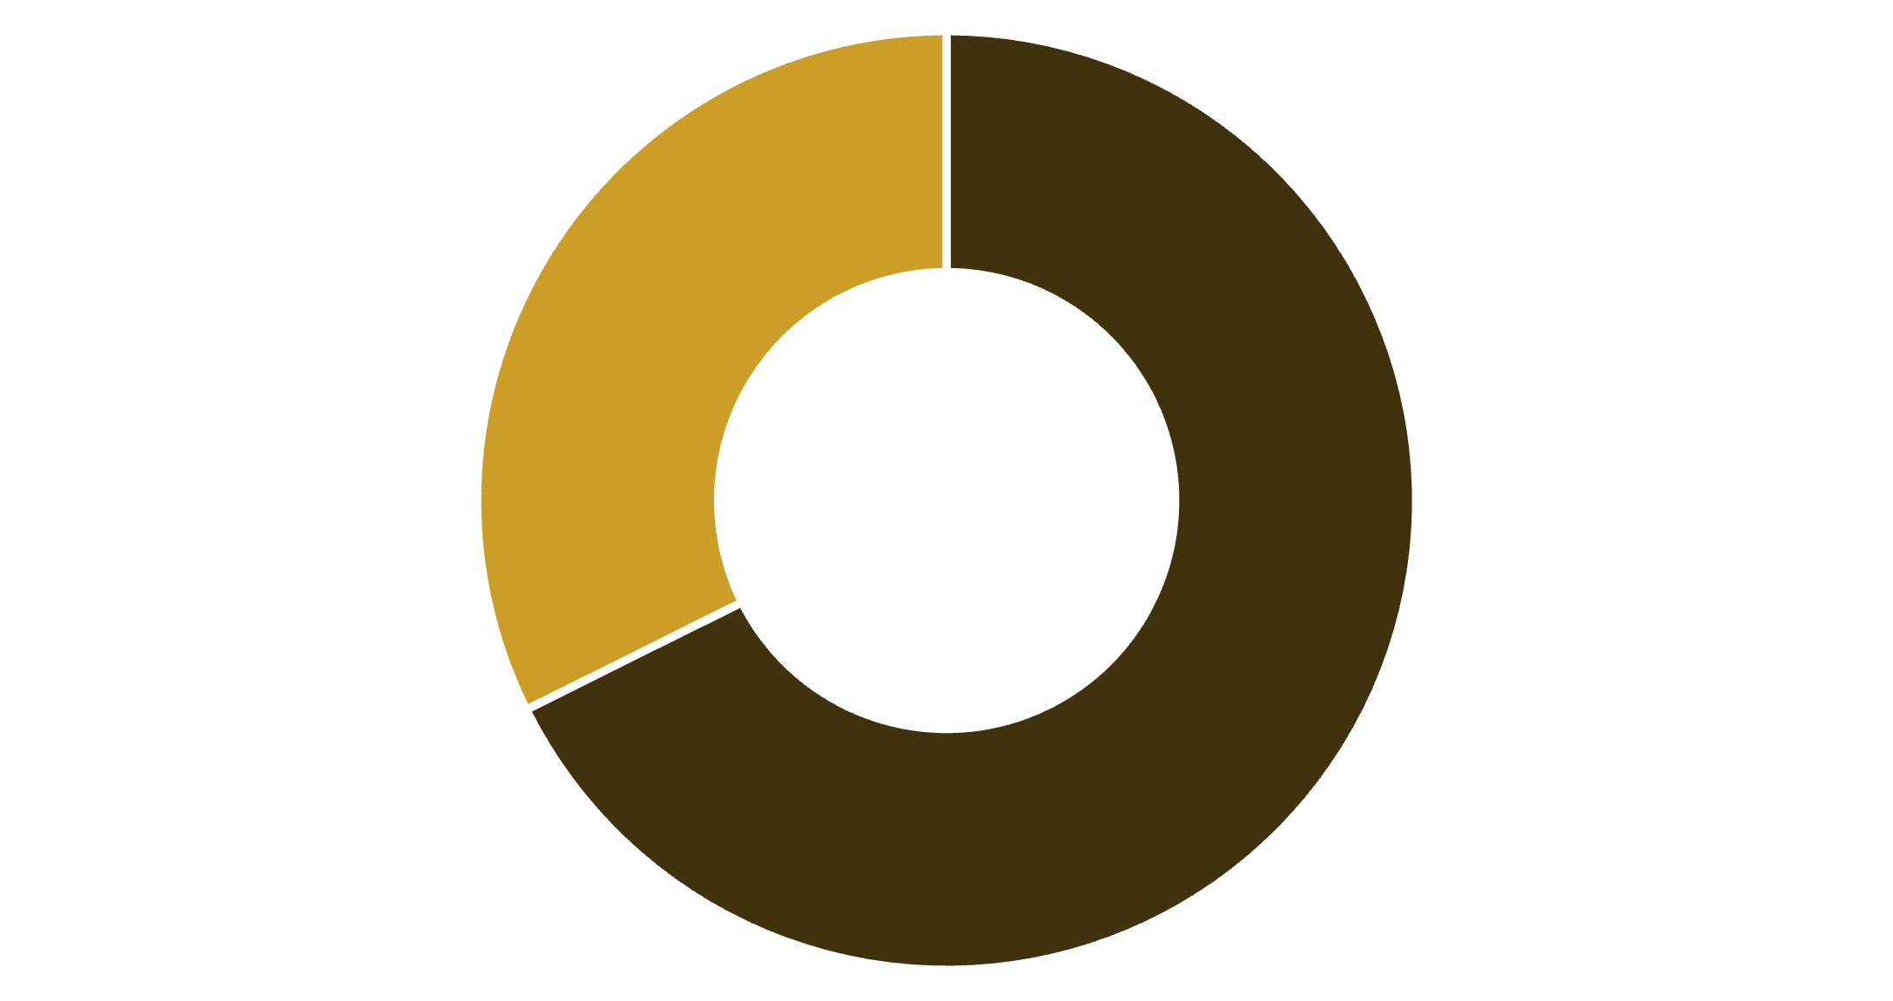
REVENUE INSIGHTS
Gender Revenue Analysis
Male Customers Drive Revenue
Male customers generate $157,890 compared to $75,191 from female customers
Represents 68% of total revenue despite being 68% of customer base
Male
Female

Slide 6
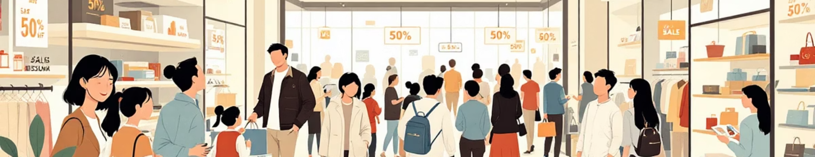
Smart Discount Users
839
21.5%
High-Spending Discount Users
Percentage of Total
Customers who used discounts but spent above average ($60)
Significant portion maximizing value without sacrificing spend

Slide 7


PRODUCT PERFORMANCE
Top-Rated Products & Shipping Insights
Highest Rated Items
3.86
3.84
3.82
Gloves
Sandals
Boots
Shipping Type Impact
Express: $60.48 avg purchase
Standard: $58.46 avg purchase
Express shoppers spend 3.5% more per transaction

Slide 8

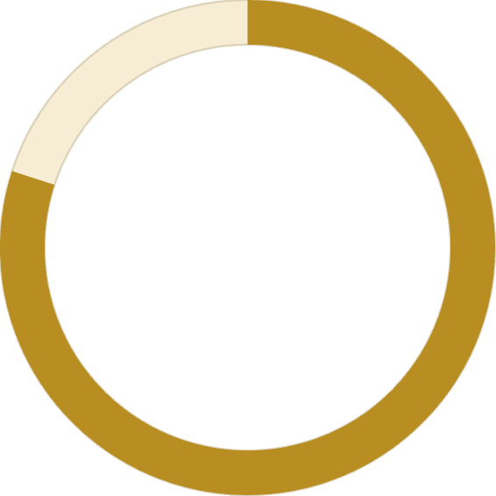
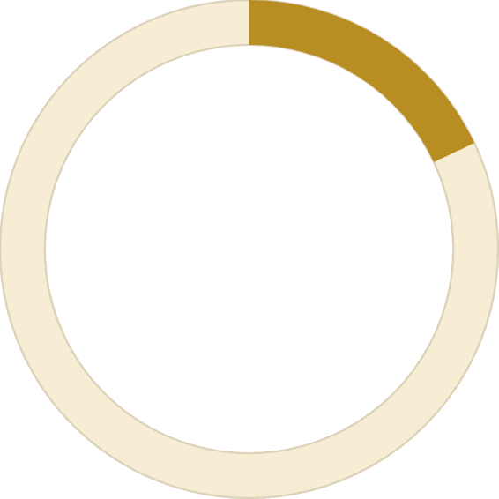

CUSTOMER SEGMENTS
Subscription & Loyalty Analysis
Subscribers
1,053 customers (27%)
$59.49 avg spend
$62,645 total revenue
Non-Subscribers
2,847 customers (73%)
$59.87 avg spend
$170,436 total revenue
80%
18%
2%
Loyal customers (3,116)
Returning customers (701)
New customers (83)

Slide 9
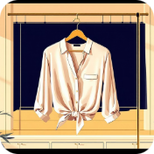


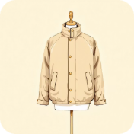
CATEGORY LEADERS
Best-Selling Products by Category
Clothing
Accessories
Footwear
Outerwear
Blouse (171), Pants (171), Shirt (169)
Jewelry (171), Sunglasses (161), Belt (161)
Sandals (160), Shoes (150), Sneakers (145)
Jacket (163), Coat (161)

Slide 10

RECOMMENDATIONS
Strategic Action Plan
Boost Subscriptions
1
Promote exclusive benefits to convert 73% non-subscribers
Loyalty Programs
2
Reward repeat buyers to strengthen 80% loyal segment
Optimize Discounts
3
Balance sales boosts with margin control for 839 smart users
Product Positioning
4
Highlight top-rated items (Gloves, Sandals, Boots) in campaigns
Targeted Marketing
5
Focus on high-revenue age groups and express shipping users

